Slide 1


Final Year Project
Tomato Care
Supervised By: Mr. Muhammad Usman Karim(Lecturer)

Slide 2
Project Team
Muhammad Salman Afaq (24775)
Usman Afaq (24779)
Rafaqat Ahmad (24784)

Slide 3
Table of Content
Introduction and Background
Literature Review and Summary Table
Problem Statement
Methodology
Progress Report Summary
Requirements
Software System (Design + Implementation + Testing)
Endeavour (Team)
Next Steps
Prototype / Report

Slide 4
INTRODUCTION AND BACKGROUND

Slide 5
Introduction
Tomato Care is a complete agricultural solution which is designed to solve the problems of farmers. This advanced platform, which is available for android leverages cutting-edge technology to revolutionize the way farmers detect and manage diseases in their tomato crops. Tomato Care aims to provide an efficient and innovative solution to empower farmers.

Slide 6
Background
Farmers are facing a serious issue with diseases affecting their tomato crops.
Recognition of the need for a more efficient and accessible disease detection solution.
We looked at what's already out there and what farmers might need by doing a lot of research Identified
A gap in existing solutions..
We got inspired by looking at other projects that did innovative things with finding plant diseases.

Slide 7
Literature Review and Summary Table
Table 1 : literature Review in Chapter 2

Slide 8
Problem Statement
Farmers face the critical challenge of timely and accurate detection of diseases in their tomato plants, which directly affects crop yield and livelihoods. Traditional methods of disease identification rely on visual inspection, which can be time-consuming. Farmers need an accessible and reliable solution that leverages technology to identify diseases quickly and effectively in tomato plants, enabling them to take proactive measures for disease management and protect their agricultural investments.

Slide 9
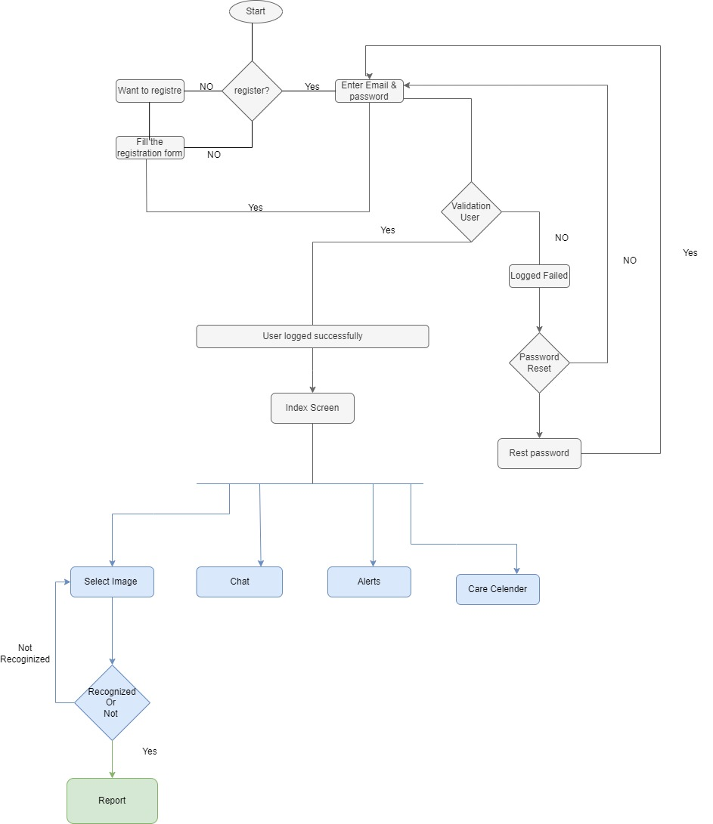
Methodology

Slide 10
PROGRESS REPORT SUMMARY

Slide 11
Requirements
Our project has two users:
User/Farmer
Admin
Use Cases : 16
Functional Requirements: 15

Slide 12
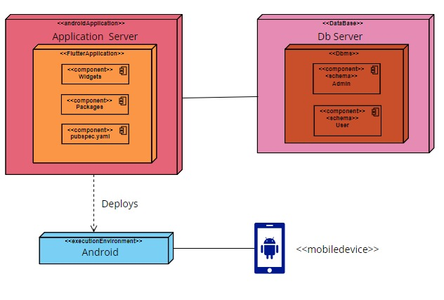
Design

Slide 13
Implementation
Development Tools & Technologies
IDEs and Tools
Backend: Python
Flutter: Visual Studio Code
Collaborative Model Training: Google Colab, Hugging face
Version Control and Document Sharing: GitHub
Technologies
Backend: Python
Framework: PyTorch, Flutter
Machine Learning: CNN Model(RestNet18)
Database: Firebase

Slide 14
Best Practices / Coding Standards
Best Practices
Version Control: GitHub
Continuous Integration and Deployment Practices
Coding Standards
Python: PEP 8
Flutter: Flutter's Coding Standards

Slide 15
Libraries / Components / Web Services
Libraries
PIL(Python Imaging library)
Google.colab
Torch vision(transforms and models)
Components
CNN Modelss
Flutter Application
Web Services
Flask API
Fire Base Database

Slide 16
Testing
Test Data | TD-1
Form | Login
Stakeholder | User
Field | Email
Technique | Equivalence Partitioning
Valid | Correct length (user@example.com) Includes numeric characters (user123@example.com). Includes country code (user@example.co.uk)
Invalid | Does not contain '@' (userexample.com).Include characters Includes characters (user@exampl*e.com).Not End with ‘.’ Includes special characters (user@ex!ample.com). Does not end with '.' (user@examplecom).

Slide 17
Testing
Test Data | TD-2
Form | Login
Stakeholder | User
Field | Password
Technique | Equivalence Partitioning
Valid | Password length should be >=6 Includes two special characters Includes uppercase and lowercase character Includes one numeric character
Invalid | Password length < 6 No uppercase and lowercase characters No special character No numeric character

Slide 18
ENDEAVOUR

Slide 19
Endeavour
Names | Roles
Muhammad Salman Afaq | Front-end, Documentation
Usman Afaq | Model-Train, Front-end, Documentation
Rafaqat Ahmad | Front-end, Back-end, Documentation

Slide 20
NEXT STEPS

Slide 21
Work Breakdown Structure (List of all Deliverables / Strikethrough Completed Deliverables)
Week 1 & 2
Project Idea
Week 3 & 4
Proposal Presentation
Week 5 & 6
Literature Review
Week 7 & 8
Finalized Technologies and Tools
Week 9 & 10
Front-End and Report Documentation
Week 11 to 14
Flutter Development
Back-end development
Week 15 and 16
Model Training
Database Connection

Slide 22
Challenges
Model Training Hurdles
Front-End Development Challenges
Model Integration
Database Connection
Finding Dataset

Slide 23
PROTOTYPE & REPORT

Slide 24
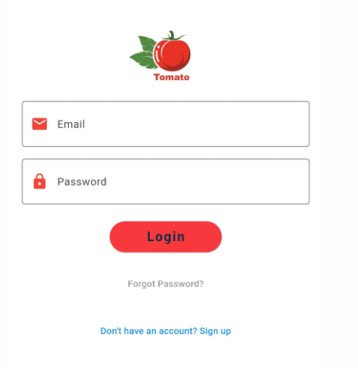
Prototype

Slide 25
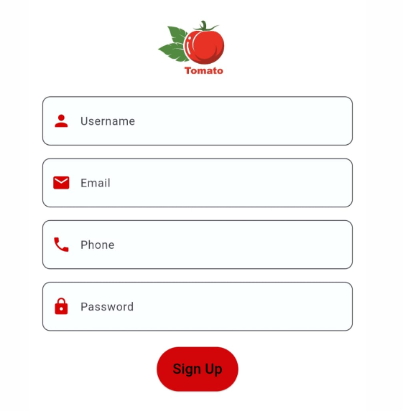
Prototype

Slide 26
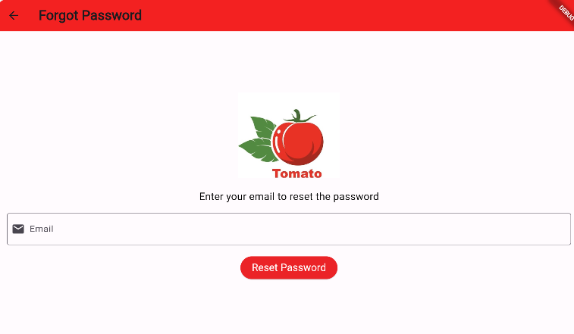
Prototype

Slide 27
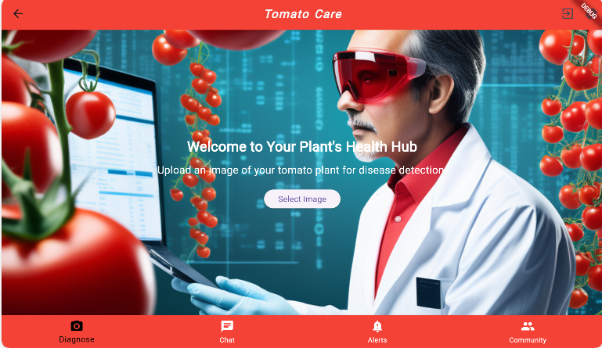
Prototype

Slide 28
Report
Chapter 1: Introduction
Chapter 2: Literature Review / Market Survey
Chapter 3: Requirements and Design
Chapter 4: Implementation and Test Cases
Chapter 5: Experiment Results and Analysis
Chapter 6: Conclusion & Future Direction

